Slide 1
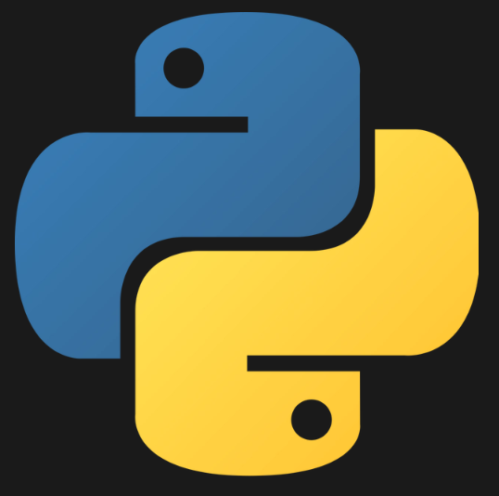
Python3 Day1

Slide 2
Agenda
Introduction to Python.
Installing Python.(Anaconda Navigator)
Introduction to pip installer.
First Program for ‘hello world’.
Data Type

Slide 3
Introduction To Python
Simple.
Easy Syntax.
Dynamically Typed.
Library.
Memory management.
Application.
Scripting(Automation)
Web development
ML
Data Science.
And many more…….

Slide 4
Anaconda Navigator:-
https://www.anaconda.com/products/individual Visit.
Download the anaconda navigator Python3 which suits your OS.
Launch it and download/Launch Jupyter notebook.

Slide 5
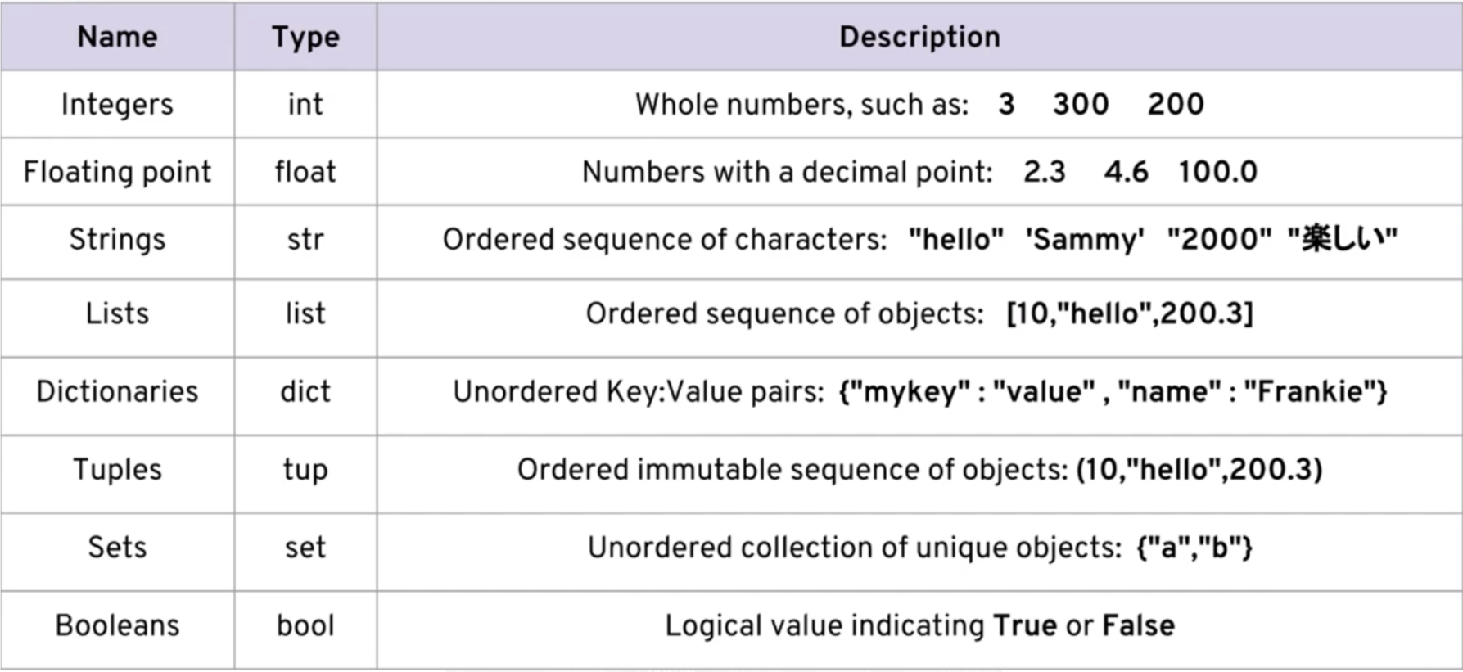
Datatypes in python:-

Slide 6
THANK YOU!!

